Slide 1
Data Mining & Knowledge Discovery
IME 672
Lecture 2

Slide 2
Knowing the Data

Slide 3
What to Know about the Data?
What are the types of attributes or fields that make up your data?
Which attributes are discrete, and which are continuous-valued?
How are the values distributed?
Are there ways we can visualize the data to get a better sense of it all?
Can we spot any outliers?
Can we measure the similarity of some data objects with respect to others?

Slide 4
Types of Data Sets
Record
Relational records
Document data: text documents: term-frequency vector
Transaction data
Graph and network
World Wide Web
Social or information networks
Molecular Structures
Ordered
Video data: sequence of images
Temporal data: time-series
Sequential Data: transaction sequences
Spatial, image and multimedia

Slide 5
Data Objects
Data sets are made up of data objects
A data object represents an entity
Examples:
sales database: customers, store items, sales
medical database: patients, treatments
university database: students, professors, courses
Also called samples, examples, instances, data points, objects, tuples
Data objects are described by attributes
Rows -> data objects
Columns ->attributes

Slide 6
Attributes
Attribute (dimensions, features, variables)
data field representing a characteristic or feature of a data object
E.g., customer _ID, name, address
Types:
Nominal
Binary
Numeric: quantitative
Interval-scaled
Ratio-scaled

Slide 7
Attribute Types
Nominal/Categorical: categories, states, or “names of things”
Hair_color = {black, blond, brown, grey, red, white}
marital status, occupation, ID numbers, zip codes
Binary: nominal attribute with only 2 states (0 and 1)
Symmetric binary: both outcomes equally important
e.g. gender
Asymmetric binary: outcomes not equally important
e.g. medical test (positive vs. negative)
Convention: assign 1 to most important outcome (e.g. HIV positive)
Ordinal: Values have a meaningful order (ranking) but magnitude between successive values is not known
Size = {small, medium, large}, grades, army rankings

Slide 8
Attribute Types
Numeric (integer or real-valued)
Interval
Measured on a scale of equal-sized units
Values have order
E.g., temperature in C˚or F˚, calendar dates
No true zero-point
Ratio
Inherent zero-point
We can speak of values as being an order of magnitude larger than the unit of measurement (10 K˚ is twice as high as 5 K˚).
e.g., temperature in Kelvin, length, counts, monetary quantities

Slide 9
Discrete vs. Continuous Attributes
Discrete Attribute
Has only a finite or countably infinite set of values
E.g. zip codes, profession, or the set of words in a collection of documents
Sometimes represented as integer variables
Continuous Attribute
Has real numbers as attribute values
E.g. temperature, height, or weight
Practically, real values can only be measured and represented using a finite number of digits
Typically represented as floating-point variables

Slide 10
Basic Statistical Descriptions of Data
To better understand the data: central tendency, variation and spread
Data dispersion characteristics
median, max, min, quantiles, outliers, variance, etc.

Slide 11
Types of Measures
Distributive measure
computed by partitioning the data into smaller subsets
Algebraic measure
computed by applying an algebraic function to one or more distributive measures
Holistic measure
computed on the entire data set as a whole
much more expensive to compute than distributive measures

Slide 12
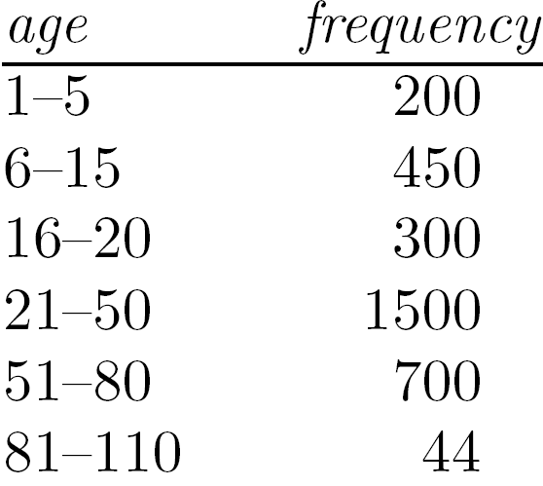
Measuring the Central Tendency
Mean:
Weighted arithmetic mean
Trimmed mean: chopping extreme values
Median:
Middle value if odd number of values, otherwise average of the middle two values
Median interval

Slide 13
Measuring the Central Tendency
Mode:
Value that occurs most frequently in the data
Unimodal, bimodal, trimodal
Empirical formula:

Slide 14
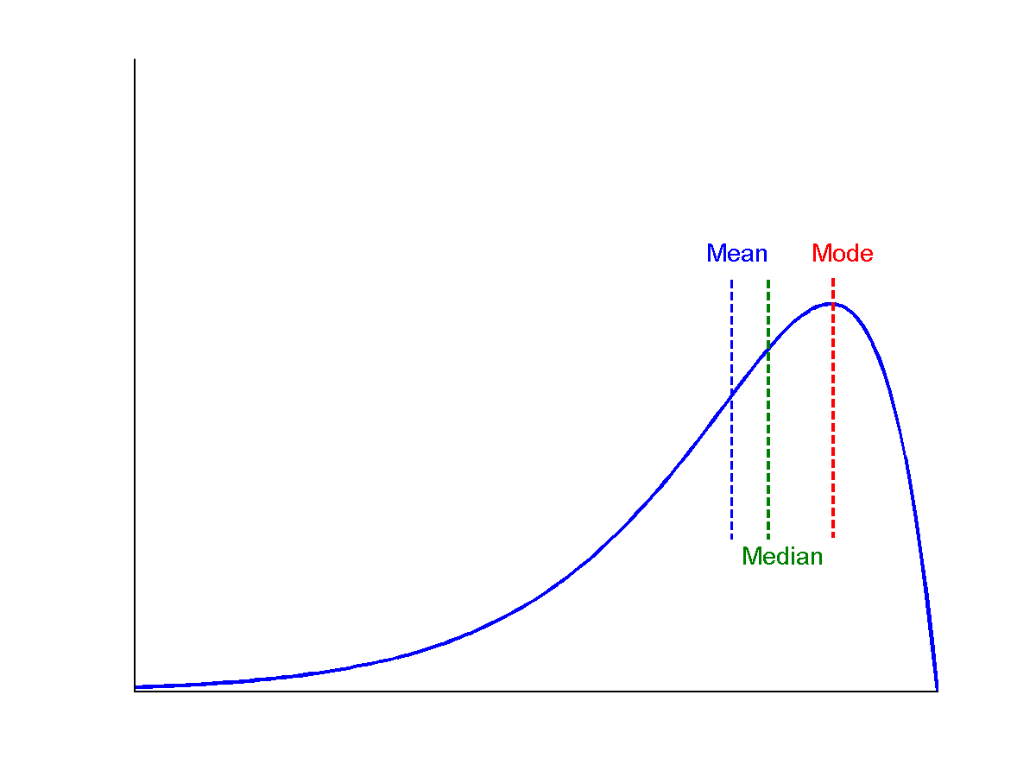
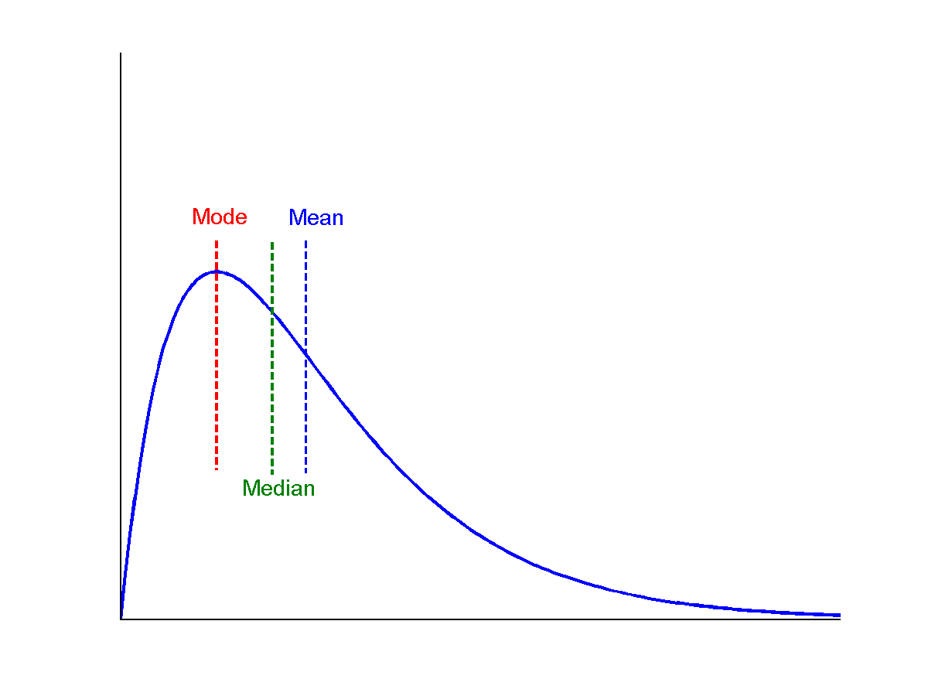
Symmetric vs. Skewed
symmetric
positively skewed
negatively skewed

Slide 15
Measuring the Dispersion of Data
Quartiles, outliers and boxplots
Quartiles: Q₁ (25th percentile), Q₃ (75th percentile)
Inter-quartile range: IQR = Q₃ – Q₁
Five number summary: min, Q₁, median, Q₃, max
Boxplot: ends of the box are the quartiles; median is marked; add whiskers, and plot outliers individually
Outlier: a value higher/lower than 1.5 x IQR
Variance and standard deviation (sample: s, population: σ)
Variance: (algebraic, scalable computation)
Standard deviation σ: is the square root of variance σ²

Slide 16
Properties of Normal Distribution Curve
The normal (distribution) curve
From μ–σ to μ+σ: contains about 68% of the measurements (μ: mean, σ: standard deviation)
From μ–2σ to μ+2σ: contains about 95% of it
From μ–3σ to μ+3σ: contains about 99.7% of it

Slide 17
Graphic Displays of Basic Statistical Descriptions
Boxplot
Histogram
Quantile plot
Quantile-quantile (q-q) plot
Scatter plot

Slide 18
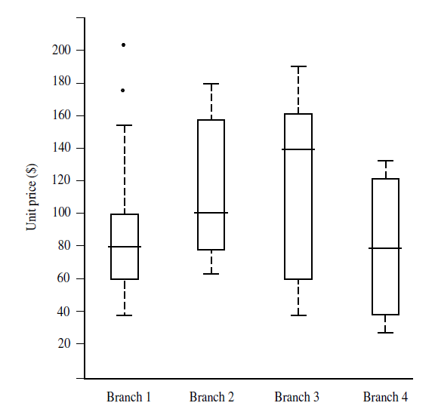
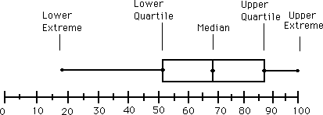
Boxplot Analysis
Five-number summary of a distribution
Minimum, Q1, Median, Q3, Maximum

Slide 19
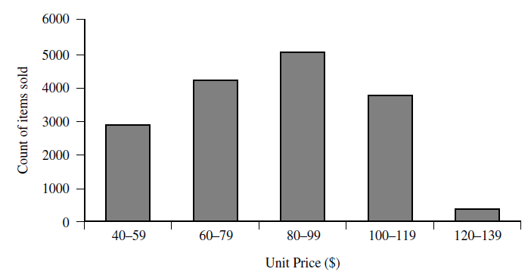
Histogram Analysis
Graphical display of tabulated frequencies, shown as bars
Shows what proportion of cases fall into each of several categories
Differs from bar chart
Bar chart -> categoric variable, Histogram -> numeric variable

Slide 20
Histograms vs. Boxplots
The two histograms shown in the left may have the same boxplot representation
The same values for: min, Q1, median, Q3, max
But they have rather different data distributions

Slide 21
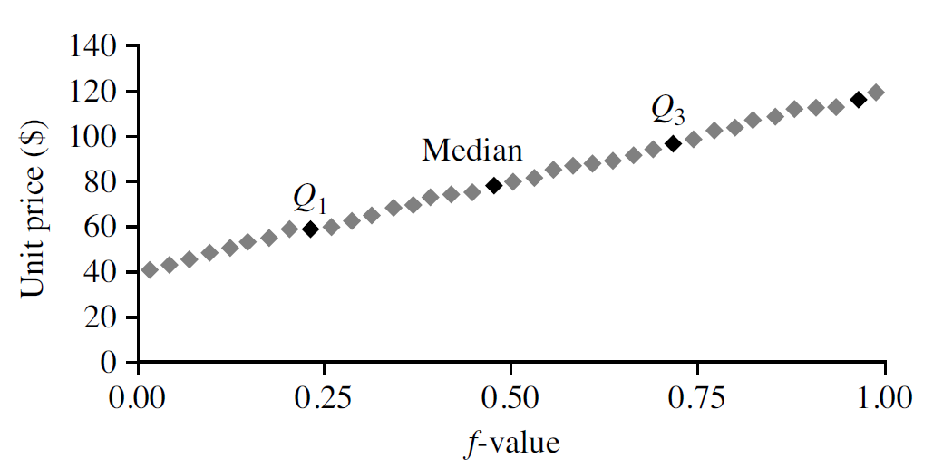
Quantile Plot
Displays all of the data for a given attribute
Assess overall behavior and unusual occurrences
Plots quantile information
Data x_{i} ’s are sorted in increasing order, (x_{i}, f_{i} ) are plotted, f_{i} indicates approximately 100 f_{i}% of the data are below or equal to the value x_{i}

Slide 22
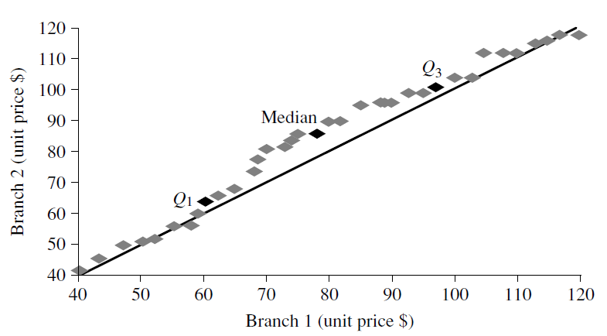
Quantile-Quantile (Q-Q) Plot
Graphs the quantiles of one univariate distribution against the corresponding quantiles of another
Objective: Is there is a shift in going from one distribution to another?
Example shows unit price of items sold at Branch 1 vs. Branch 2 for each quantile. Unit prices of items sold at Branch 1 tend to be lower than those at Branch 2

Slide 23
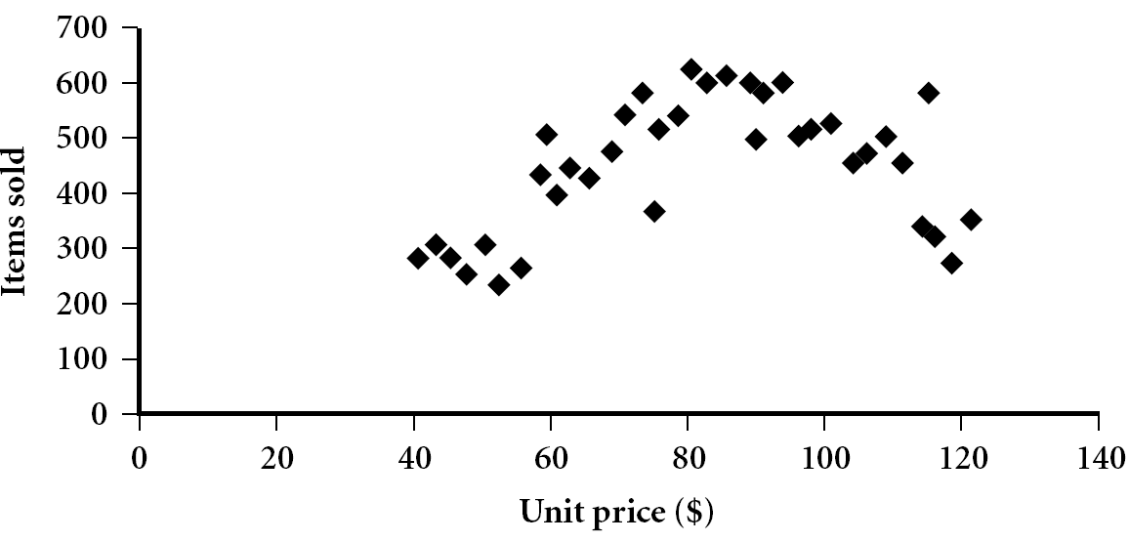
Scatter plot
Graphical methods to determine if there appears to be a relationship, pattern, or trend between two numerical attributes
Each pair of values is treated as a pair of coordinates and plotted as points in the plane

Slide 24
Positively and Negatively Correlated Data
The left half fragment is positively correlated
The right half is negative correlated

Slide 25
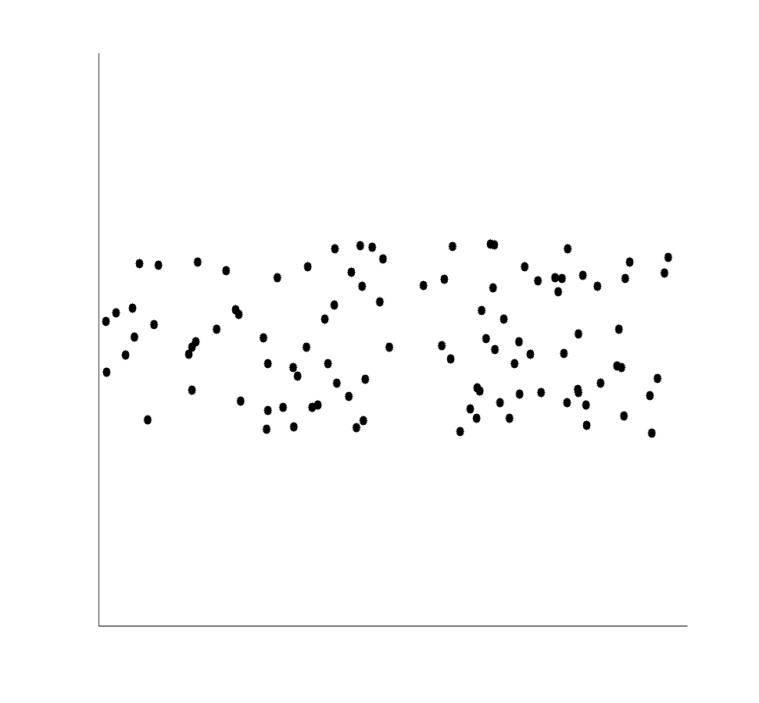
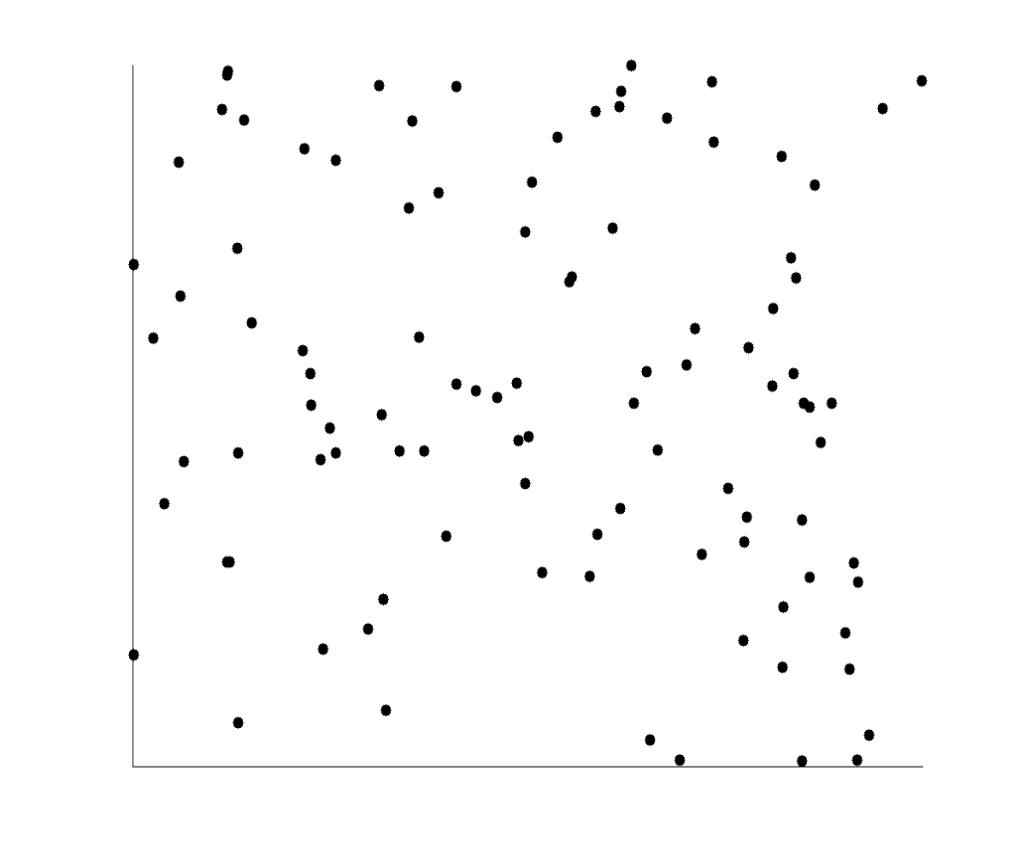
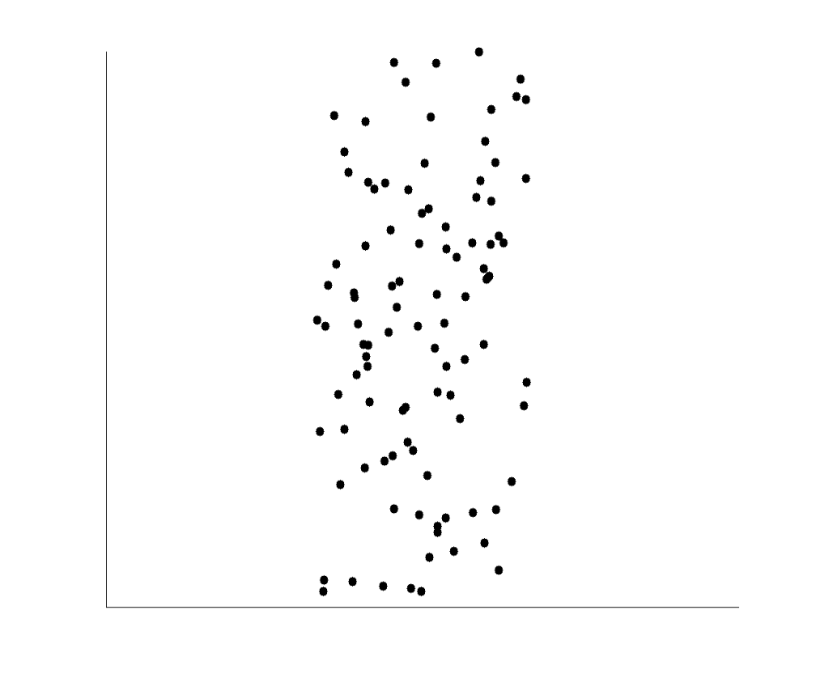
Uncorrelated Data

Slide 26
Data Visualization
Gain insight into an information space by mapping data onto graphical primitives
Search for patterns, trends, structure, irregularities, relationships among data
Help find interesting regions and suitable parameters for further quantitative analysis
Categorization of visualization methods:
Pixel-oriented visualization techniques
Geometric projection visualization techniques
Icon-based visualization techniques
Hierarchical visualization techniques
Visualizing complex data and relations

Slide 27
Pixel-Oriented Visualization Techniques
For a data set of m dimensions, create m windows on the screen, one for each dimension
The m dimension values of a record are mapped to m pixels at the corresponding positions in the windows
The colors of the pixels reflect the dimension values
Income
(b) Credit Limit
(c) transaction volume
(d) age
Notes:
27

Slide 28
Geometric Projection Visualization Techniques
Visualization of geometric transformations and projections of the data
Methods
Direct visualization
Scatterplot and scatterplot matrices
Landscapes
Projection pursuit technique: Help users find meaningful projections of multidimensional data
Prosection views
Hyperslice
Parallel coordinates

Slide 29
Icon-Based Visualization Techniques
Visualization of the data values as features of icons
Typical visualization methods
Chernoff Faces
Stick Figures
General techniques
Shape coding: Use shape to represent certain information encoding
Color icons: Use color icons to encode more information
Tile bars: Use small icons to represent the relevant feature vectors in document retrieval

Slide 30
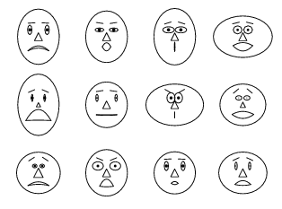
Chernoff Faces
A way to display variables on a two-dimensional surface, e.g., let x be eyebrow slant, y be eye size, z be nose length, etc.
The figure shows faces produced using 10 characteristics--head eccentricity, eye size, eye spacing, eye eccentricity, pupil size, eyebrow slant, nose size, mouth shape, mouth size, and mouth opening): Each assigned one of 10 possible values, generated using Mathematica (S. Dickson)
REFERENCE: Gonick, L. and Smith, W. The Cartoon Guide to Statistics. New York: Harper Perennial, p. 212, 1993
Weisstein, Eric W. "Chernoff Face." From MathWorld--A Wolfram Web Resource. mathworld.wolfram.com/ChernoffFace.html

Slide 31
Hierarchical Visualization Techniques
Visualization of the data using a hierarchical partitioning into subspaces
Methods
Dimensional Stacking
Worlds-within-Worlds
Tree-Map
Cone Trees
InfoCube

Slide 32
Measuring Data Similarity and Dissimilarity
Similarity
Numerical measure of how alike two data objects are
Value is higher when objects are more alike
Often falls in the range [0,1]
Dissimilarity (e.g., distance)
Numerical measure of how different two data objects are
Lower when objects are more alike
Minimum dissimilarity is often 0
Upper limit varies
Proximity refers to a similarity or dissimilarity

Slide 33
Data Matrix and Dissimilarity Matrix
Data matrix
n data points with p dimensions
n objects × p attributes
Dissimilarity matrix
Proximities for all pairs of n objects
n objects × n objects

Slide 34
Proximity Measure for Nominal Attributes
Computing dissimilarity between objects described by nominal attributes
Method 1: Simple matching
m: # of matches, p: total # of attributes
Method 2: Use a large number of binary attributes
creating a new binary attribute for each of the M nominal states

Slide 35
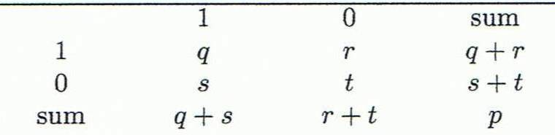
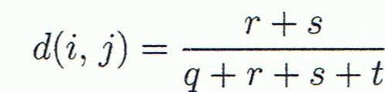

Proximity Measure for Binary Attributes
A contingency table for binary data
Distance measure for symmetric binary variables
Jaccard coefficient (similarity measure for asymmetric binary variables)
Jaccard coefficient is the same as “coherence”
Object j
Object i

Slide 36
Dissimilarity between Binary Variables
Example
Gender is a symmetric attribute
The remaining attributes are asymmetric binary
Let the values Y and P be 1, and N be 0

Slide 37
Proximity Measure for Numeric Attributes
Minkowski distance: A popular distance measure
where i = (x_{i1}, x_{i2}, …, x_{ip}) and j = (x_{j1}, x_{j2}, …, x_{jp}) are two p-dimensional data objects, and h is the order (the distance so defined is also called L_{h} norm)
Properties
d(i, j) > 0 if i ≠ j, and d(i, i) = 0 (Positive definiteness)
d(i, j) = d(j, i) (Symmetry)
d(i, j) ≤ d(i, k) + d(k, j) (Triangle Inequality)
A distance that satisfies these properties is a metric

Slide 38
Special Cases of Minkowski Distance
h = 1: Manhattan (city block, L₁ norm) distance
E.g., the Hamming distance: the number of bits that are different between two binary vectors
h = 2: (L₂ norm) Euclidean distance
h → ∞. “supremum” (L_{max} norm, L∞ norm) distance
This is the maximum difference between any component (attribute) of the vectors

Slide 39
Example: Minkowski Distance
Dissimilarity Matrices
Manhattan (L₁)
Euclidean (L₂)
Supremum

Slide 40
Proximity Measure for Ordinal Attributes
An ordinal variable can be discrete or continuous
Order is important, e.g., rank
Can be treated like interval-scaled
replace x_{if} by their rank
map the range of each variable onto [0, 1] by replacing i-th object in the f-th variable by
compute the dissimilarity using methods for numeric attributes

Slide 41
Dissimilarity for Attributes of Mixed Type
A database may contain all attribute types
Nominal, symmetric binary, asymmetric binary, numeric, ordinal
One may use a weighted formula to combine their effects
f is binary or nominal:
d_{ij}^{(f)} = 0 if x_{if} = x_{jf} , otherwise d_{ij}^{(f)} = 1
f is numeric: use the normalized distance
f is ordinal
Compute ranks r_{if} and
Treat z_{if} as numeric

Slide 42
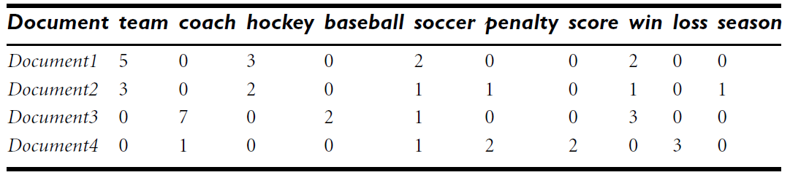
Cosine Similarity
A document can be represented by thousands of attributes, each recording the frequency of a particular word (such as keywords) or phrase in the document
Other vector objects: gene features in micro-arrays, …
Applications: information retrieval, biologic taxonomy, gene feature mapping, ...
Cosine measure: If d₁ and d₂ are two vectors (e.g., term-frequency vectors), then
cos(d₁, d₂) = (d₁ • d₂) /||d₁|| ||d₂|| ,
where • indicates vector dot product, ||d||: the Euclidean norm

Slide 43
Example: Cosine Similarity
The measure computes the cosine of angle between vectors d₁ and d₂
Ex: Find the similarity between documents 1 and 2.
d₁ = (5, 0, 3, 0, 2, 0, 0, 2, 0, 0)
d₂ = (3, 0, 2, 0, 1, 1, 0, 1, 0, 1)
d₁•d₂ = 5*3+0*0+3*2+0*0+2*1+0*1+0*1+2*1+0*0+0*1 = 25
||d₁||= (5*5+0*0+3*3+0*0+2*2+0*0+0*0+2*2+0*0+0*0)^{0.5}=(42)^{0.5} = 6.48
||d₂||= (3*3+0*0+2*2+0*0+1*1+1*1+0*0+1*1+0*0+1*1)^{0.5}=(17)^{0.5} = 4.12
cos(d₁, d₂ ) = 0.94

Slide 44
Summary
Data attribute types: nominal, binary, ordinal, interval-scaled, ratio-scaled
Many types of data sets, e.g., numerical, text, graph, Web, image.
Gain insight into the data by:
Basic statistical data description: central tendency, dispersion, graphical displays
Data visualization: map data onto graphical primitives
Measure data similarity
Above steps are the beginning of data preprocessing

